Slide 1
Welcome to Reception!

Slide 2
During the Reception year we will continue to work through the Early Years Framework already introduced in Nursery and
Pre-school.

Slide 3
EYFS Curriculum
7 areas of learning:
Personal, Social & Emotional
Development
Physical Development
Communication and Language
Literacy
Mathematics
Expressive Arts and Design
Understanding the World

Slide 4
Throughout the Reception year your child will be involved in a wide range of activities, experiences and tasks relating to the seven areas of learning .
These are all designed to support your child in achieving the Early Learning Goals by the end of the year.
games
Small world
music
water
dance
Role-play
sand
paint

Slide 5
Early Learning Goals are the criteria that children are assessed against at the end of Reception year.
Emerging Expected
17 ELG’s relating to the 7 areas of learning.

Slide 6
Expectations
Throughout this year your child will be observed in various tasks and activities, both adult directed and child-initiated, in order for the adults in the setting to make a judgement about how well each child has achieved each of the 17 Early Learning Goals.
1 = Emerging
2 = Expected

Slide 7
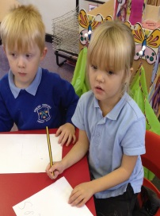
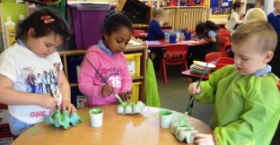
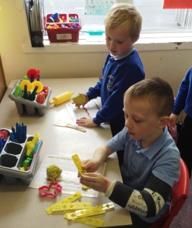
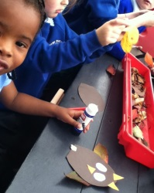
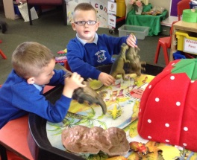
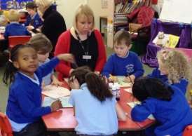
Getting the right balance
Child-led
Adult-led

Slide 8
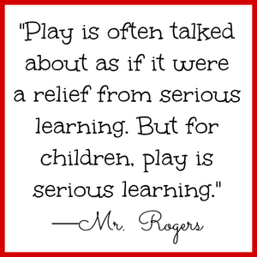
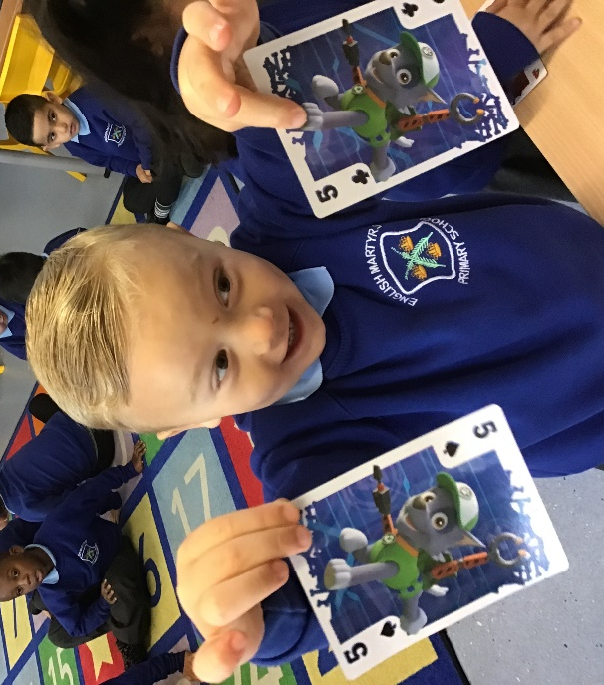
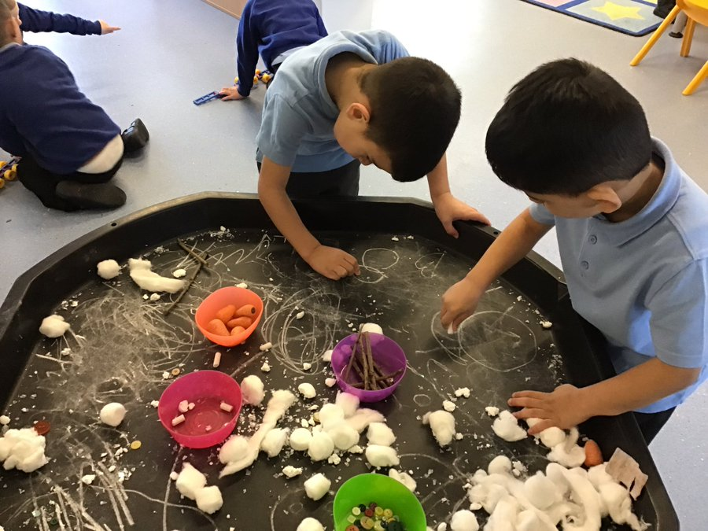
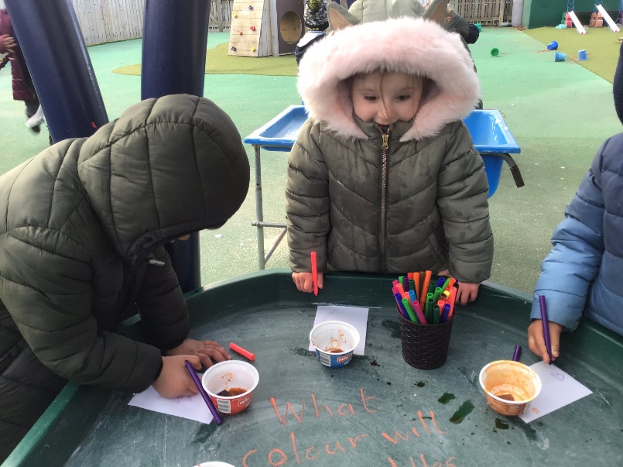
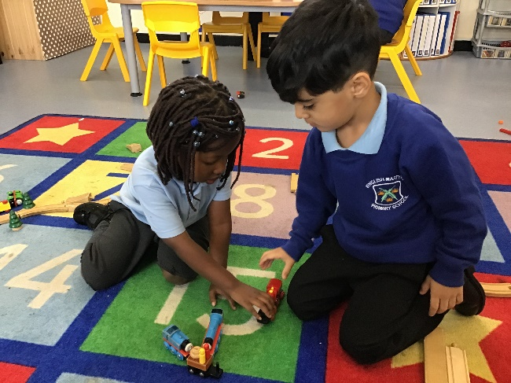

Slide 9
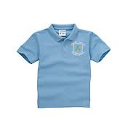
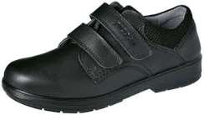
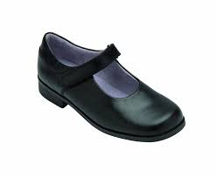
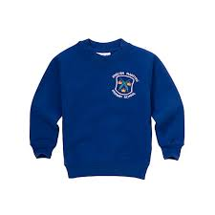
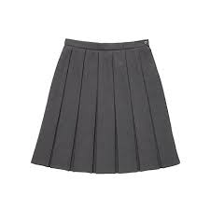
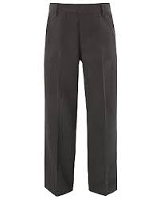
School uniform
Pale blue polo shirt
Black shoes
Royal blue sweatshirt or cardigan
Grey skirt or pinafore
Grey trousers
Children will take part in PE lessons in the summer term, you are welcome to wait until year 1 to buy the PE uniform. Any shorts/t-shirt or joggers/hoodies will be fine!

Slide 10
English Martyrs’ school uniform is available from:
Address:
4 Moulton Place
Newcastle Upon Tyne
Tyne & Wear
NE5 3RL
Phone: 0191 271 0000

Slide 11
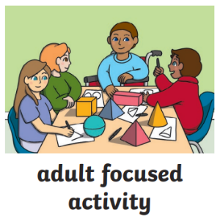
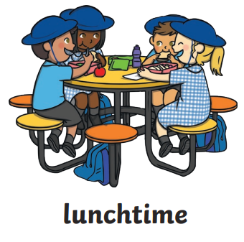
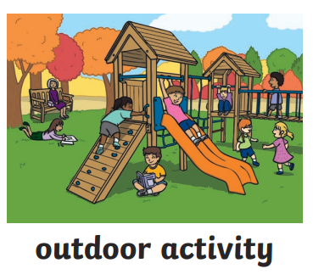
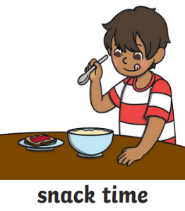
What does an average day look like?
A.M
P.M

Slide 12
English Martyrs’
Needs you!

Slide 13
Encouraging Independence
Developing independence will enable your child to feel safe and secure in school. Please help your child to do this by:
Allowing them to come into school independently.
Encouraging them to get dressed themselves.
Making sure they are prepared for school each day with their book bag, water bottle and waterproof.
Ensuring all belongings are clearly labelled.
As part of the PSED MANAGING SELF ELG children will be expected to, “manage their own basic hygiene and personal needs, including dressing and going to the toilet.”

Slide 14
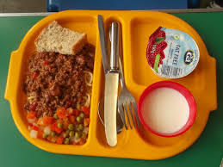
Lunchtime
Some children can find it difficult to choose what they would like to eat for lunch.
Please spend time looking at the menu with your child to help them to make the right choices for them.
It is also useful if your children are able to use a knife and fork independently.
Menus can be found on the school website!

Slide 15
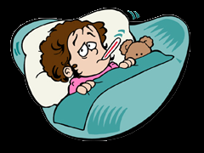
Attendance & Punctuality
Being on time is important. It helps the children to have a good start each day and helps develop good habits for school.
Coming to school every day is important. If children are absent they miss out on important areas of the curriculum.
Please let us know if your child is ill and please try not to take holidays during school time.

Slide 16
Getting Ready for School Sessions
Wednesday 26th June 2024
STAY & PLAY CLASSROOM VISIT
For CHILDREN and PARENTS/CARERS
A.M – 11.00-11.40 RF (Mrs Foster)
P.M – 2.30- 3.10 RP (Miss Phelan)
Entrance via NETHERBY DRIVE

Slide 17
Reception Class visit 2
Friday 12th July 2024
All children are invited to spend the morning in Reception Class. 9.15-11.30 am (CHILDREN ONLY)
If your child already attends English Martyrs’ Nursery, please arrive at Nursery as normal and Nursery staff will take your children to Reception class. Reception staff will then return children to Nursery for lunch and the afternoon session.
If your child is new to us, please arrive at the Netherby Drive entrance where you will be directed to the drop off gate. Children will be collected from the same place at 11.30am.

Slide 18
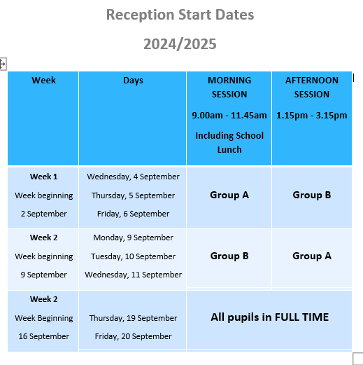
September
All children start school on Wednesday 4th September 2024.
To help us settle your children into school, each class has been split into two groups.
Group A
Group B

Slide 19
Points to remember:
The reception gates will open from 8.40am and will close promptly at 8.50am so please be on time.
Make sure all uniform is clearly labelled.
Take time to look at the lunch menu each day with your child.
Encourage independence.

Slide 20
Check the
website!
www.emcps.co.uk
Make sure we have an up to date phone number as we often send messages out to you via text.

